Slide 1
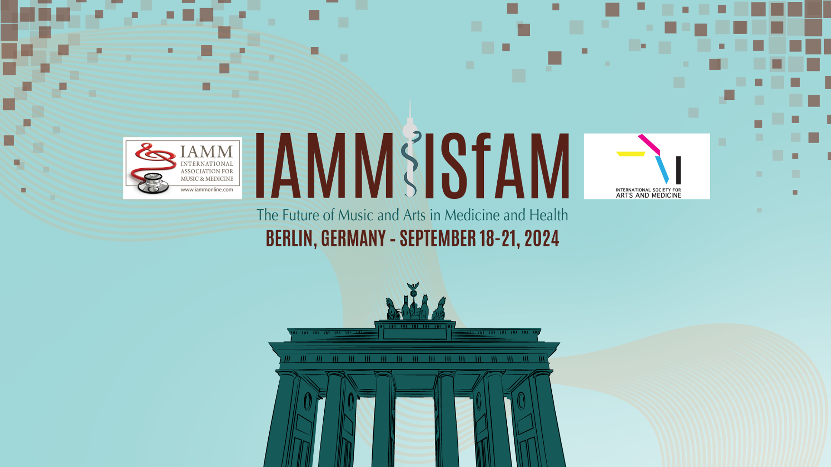
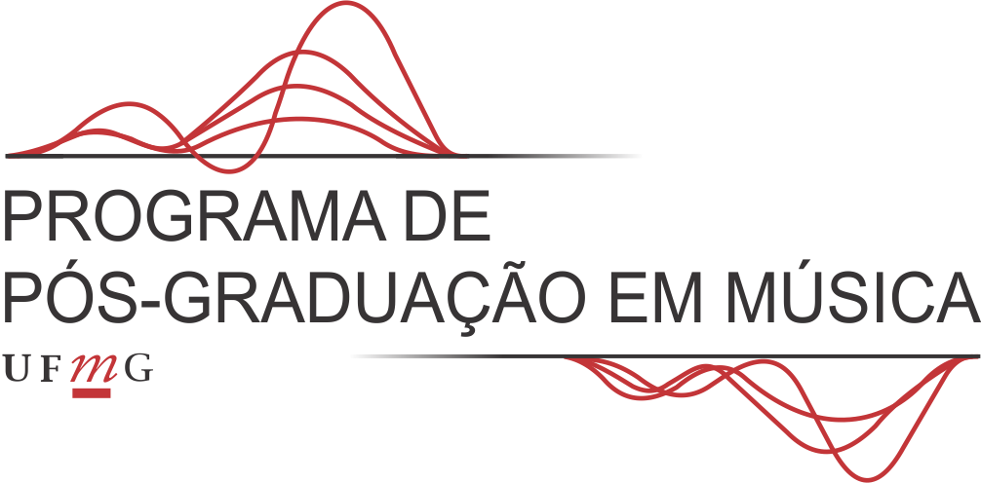


AN MUSIC THERAPEUTICAL PERSPECTIVE ON SOCIAL COGNITION AND MUSIC: INTERACTIVE MUSICAL IMPROVISATION
PhD (C) Ivan Moriá Borges Rodrigues (Presenting)
Dr. Renato Tocantins Sampaio (Supervisor)
UNIVERSIDADE FEDERAL DE MINAS GERAIS - BRAZIL

Slide 2


Motivation for this research
Previous research conduct during my Master's in Neurosciences (UFMG-Brazil)
The relationship between interactive musical improvisation and social cognition in a clinical setting with patients diagnosed with schizophrenia;
Social Cognition
theory of mind, processing and perception of emotions, working memory
The practice of spontaneous and collaborative musical creation between a client and a music therapist
Interactive Musical Improvisation is commonly employed in Music Therapy sessions in Brazil
There is a limited number of references addressing these concepts
Koelsh (2009) Croom (2015) He et al (2018)
Passive musical intervention
“modulation of perception as an important factor for understanding the effects of Music Therapy on health promotion and Social Cognition”

Slide 3

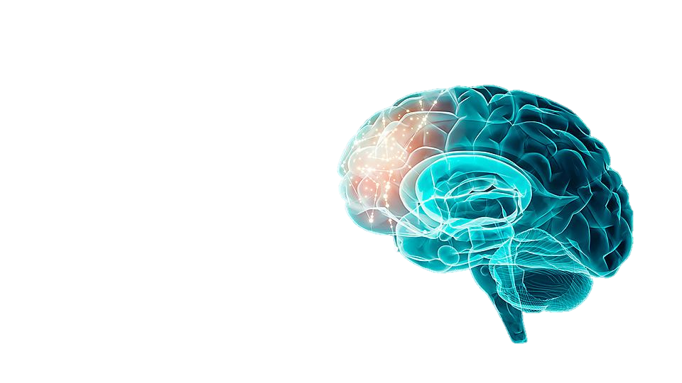

The results of this previous work highlight the relationship between some domains of Social Cognition (SC) and rhythmic, melodic, and harmonic synchrony.
Background
The social elements that emerge in musical improvisation are numerous and complex.
The variety of elements found in this type of practice provides a broader view of SC, as they engage various cognitive processing structures to adapt to the proposed musical forms.
Prefrontal cortex in detail. Art by University of Plymouth, UK
Moriá & Sampaio (2021)

Slide 4



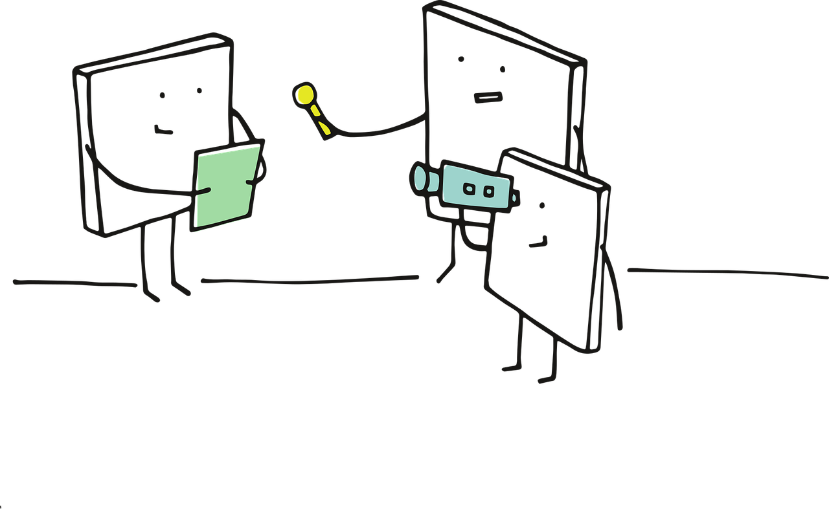

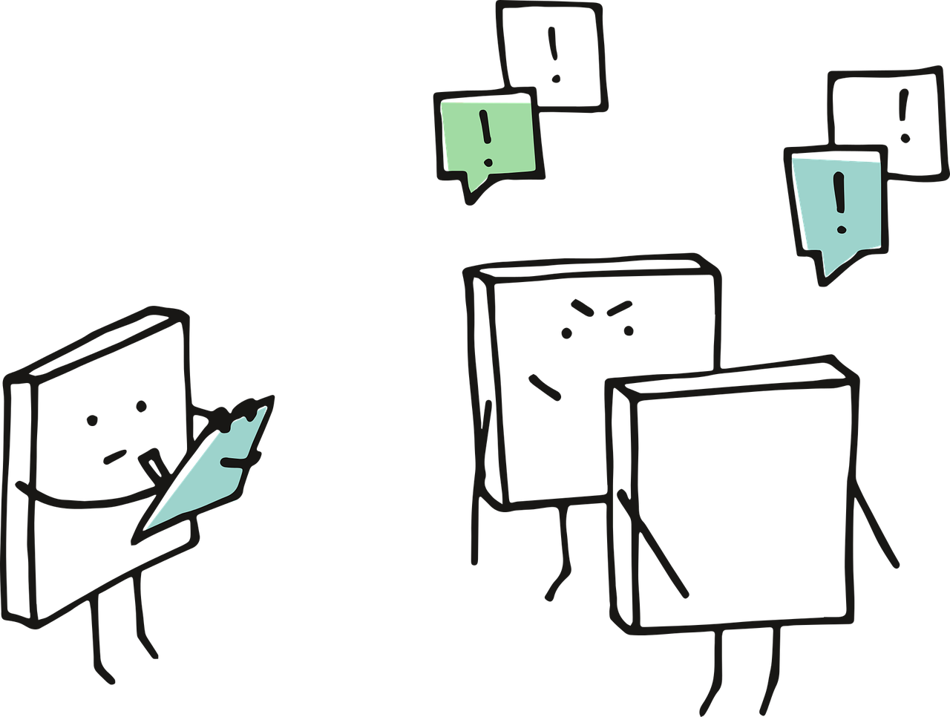
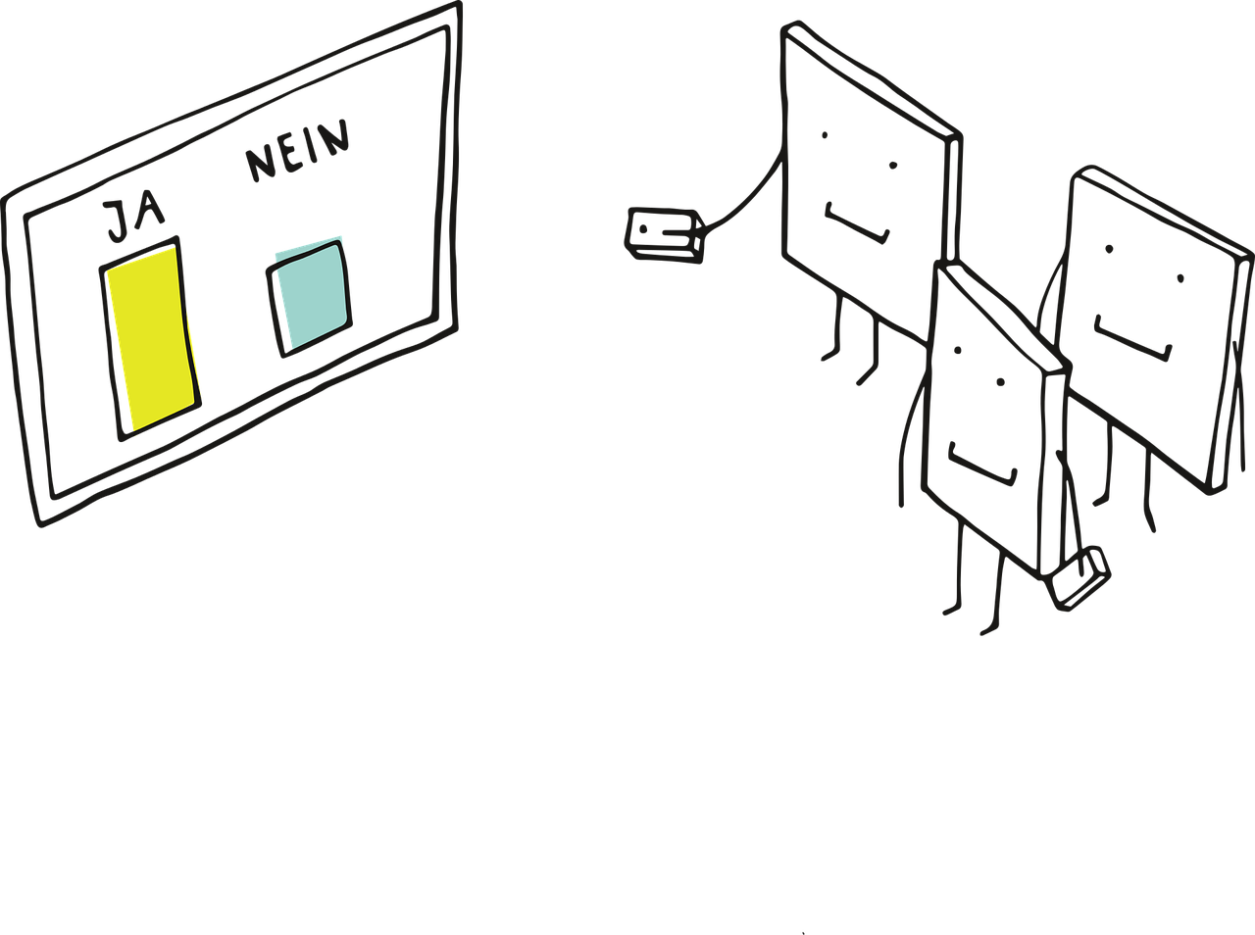
How can this be assessed?
Qualitative x Quantitative methods
Review of records (music therapy or records from other professionals)
Interviews
(structured or unstructured)
Observations (from recorded audio or video of the music therapy session)
Tests and measures (quantitative evaluation methods based on a standard of expected responses)
Gattino (2020 p.35)

Slide 5


Researching ways to extract precise results
Music Information Retrieval (MIR):
Focuses on the development of efficient and effective methods and technology for extracting useful information from music data.
Many MIR approaches have focused on the analysis of audio signals, but visualizations can also be obtained from other time series data, such as MIDI and motion data (Agres et al., 2022)
Musical Instrument Digital Interface (MIDI):
There are MIDI drum pads, wind controllers, guitar, and other string controllers, as well as pitch-to-MIDI conversion systems designed to take input from a microphone and convert the signal into MIDI information. (Clarke, 2004)
Music Therapy Toolbox (MTTB):
Analyzes MIDI data from music therapy improvisations for quantitative analysis. However, it uses expensive software such as MATLAB (MathWorks Inc.), which is mainly inaccessible to most music therapists who usually do not have regular training in these tools. (Erkkilä, 2007).

Slide 6
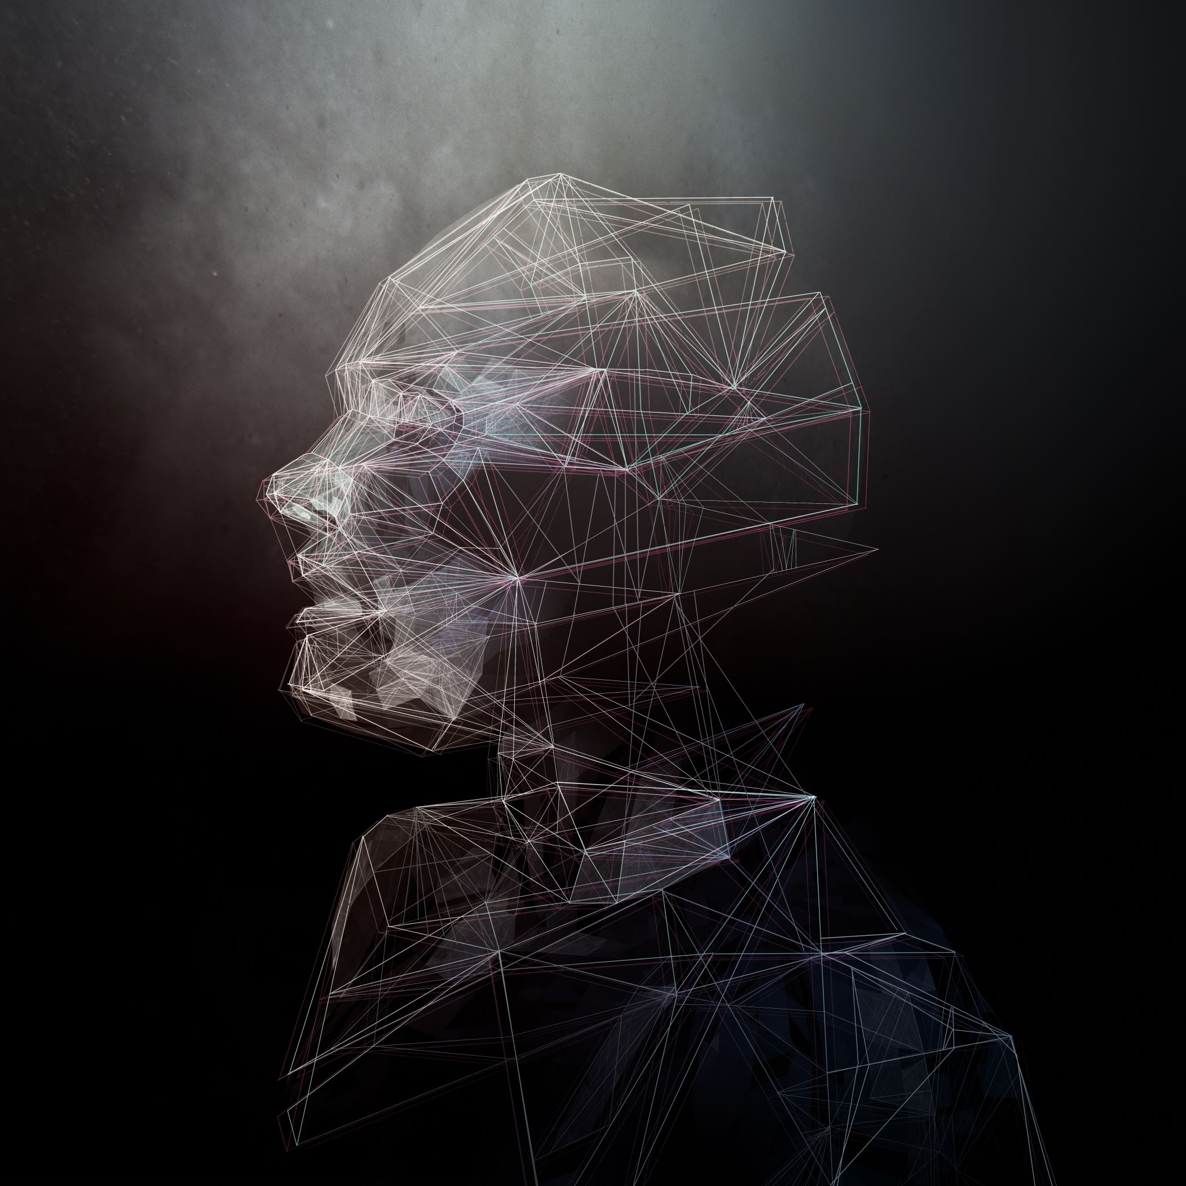
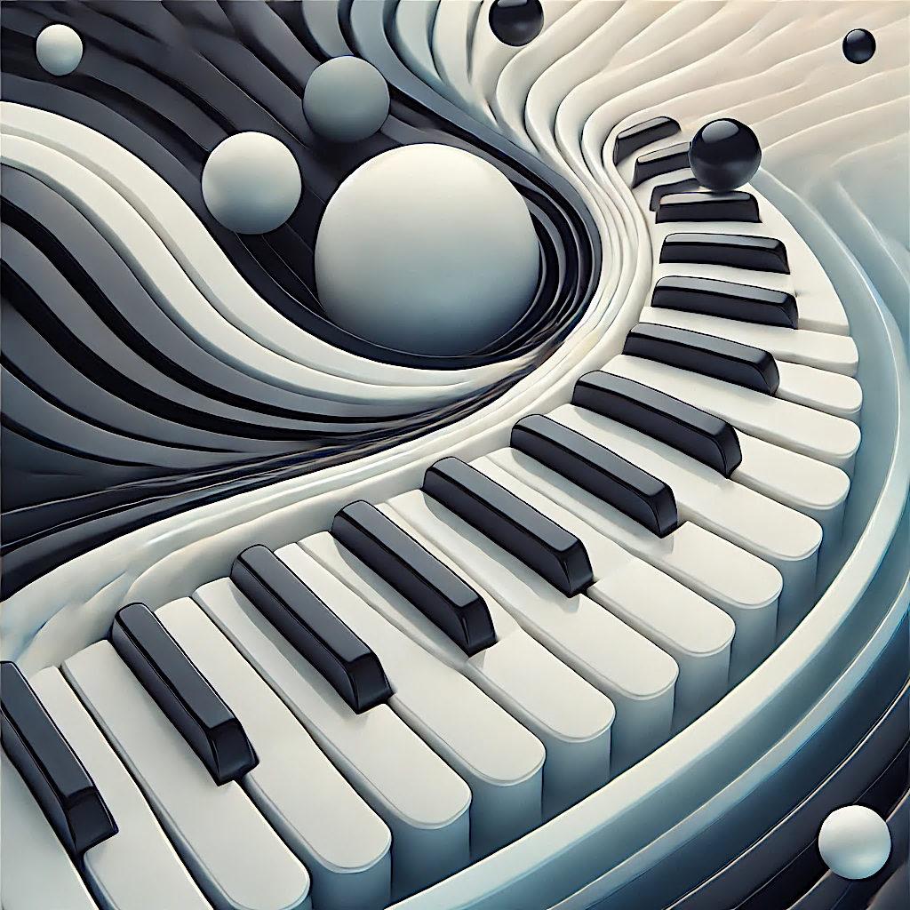
The limitations of MIDI
Expression, interpretation, timbre, and other musical elements;
Physical and social dimensions of the performance, such as interactions with listeners and a wide range of visual data, like the performer’s facial expressions, can also be considered.
Some of these behaviours have been studied independently.
Clarke, E. (2004)

Slide 7


Time schedule
2021
Learning about programming and technology in Music Therapy, and identifying areas where I can contribute to research
2022
Researching articles on the concept of Music Information Retrieval in Music Therapy, the use of MIDI data for research, and the application of technological tools in Music Therapy.
2023
Conducting interviews with experts in Music Therapy to explore their use of technological tools and gather evaluative feedback on this ongoing research.
2024
Development of programming languages such as Max/MSP (Cycling '74) and Python for processing MIDI data, as well as for creating a musical test and developing visual and statistical analyses

Slide 8

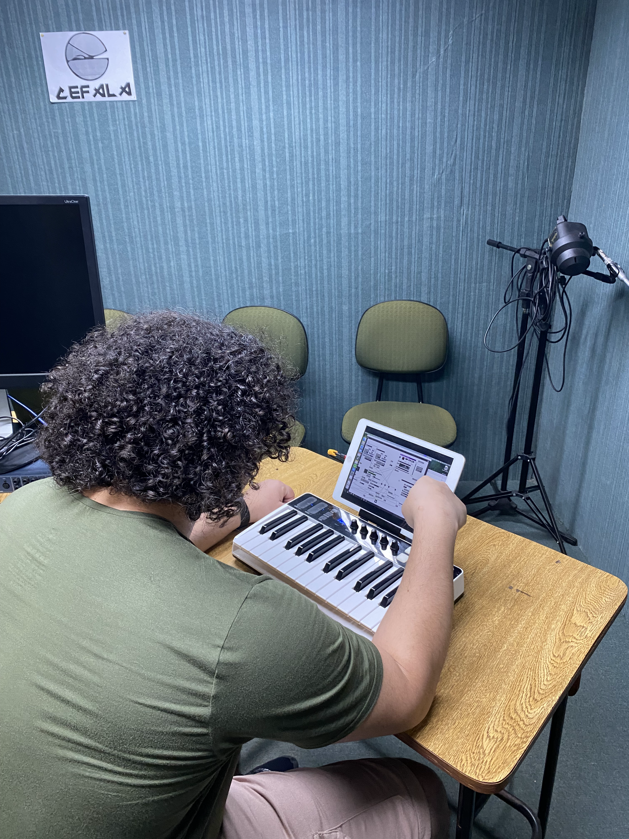

The MIR-MT Project
Musical excerpt example: AllaTurca (from Sonata No. 11 in A major, K. 331: III.), with Brazilian rhythms (Baião) and shifting time signatures
Materials: iRig I/O 25 Keys (IK Multimedia); Laptop with MAX/MSP and Python installed for data processing; Second Monitor for providing visual feedback to participants
Pilot project with 6 volunteers to test the interface and musical test - started in August 2024;
Conducted at CEFALA - Center for Research on Speech, Acoustics, Language & Music. Department of Electronic Engineering (DELT-UFMG);
Participants will interact musically through a digital MIDI instrument that processes all the musical information played, with unexpected changes in musical elements to explore relationships with social cognition;

Slide 9
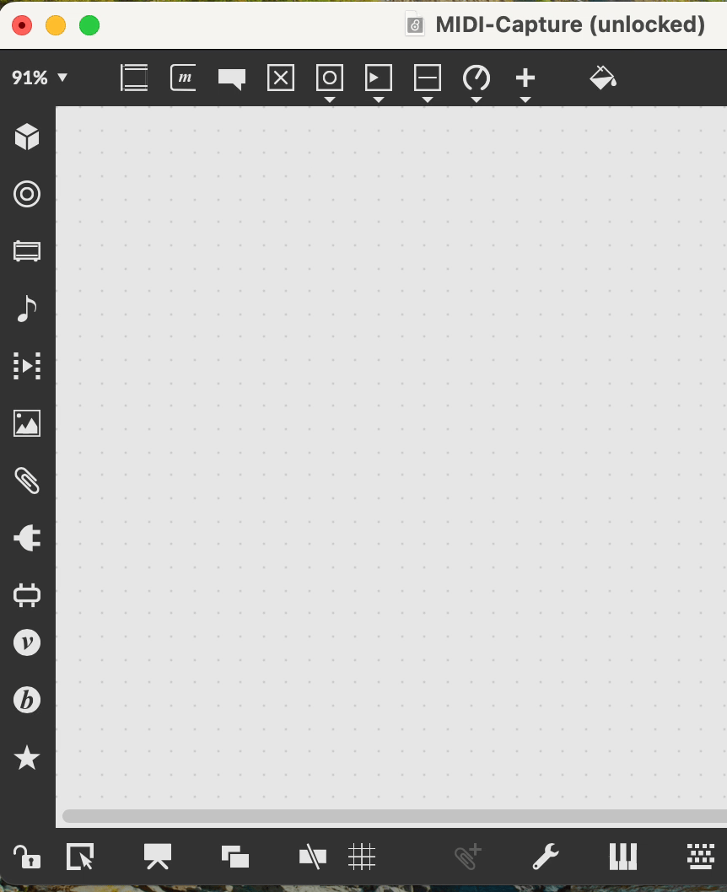
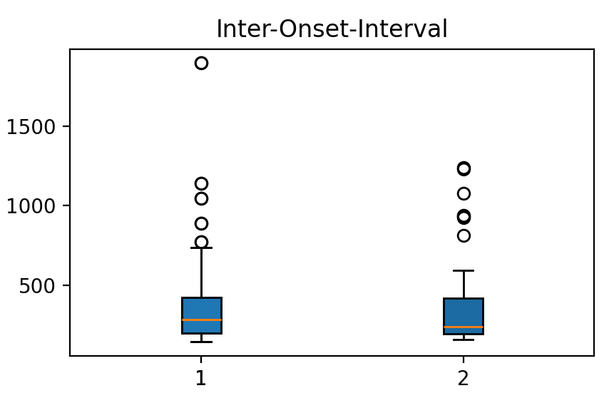
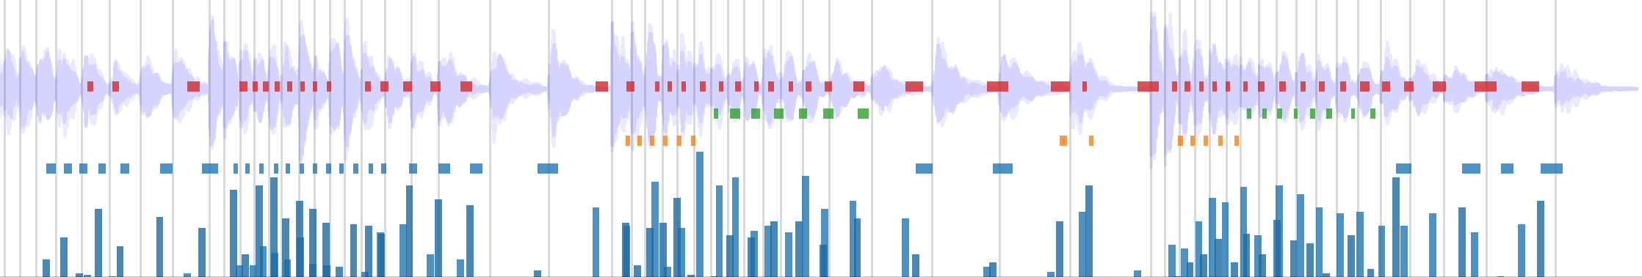
Reflections
Programming in MAX/MSP as a Music Therapy researcher;
This research project aims to identify factors that hinder access to this wealth of data, explore ways to make these tools more accessible for music therapists, and investigate opportunities for the ongoing development of platforms that utilize MIDI technology for research.
We hope that this experiment will enable us to quantitatively visualize participant’s levels of perception and the relationship between various musical stimuli and musical responses related to rhythmic aspects such as anticipation, delay, synchronization, perception, working memory and understanding of symbolic structures, among others.
Data examples
predetermined expected moment
Waveform
Key pressed (color) Duration (lenght)
Velocity
MAX/MSP Patch
Collect MIDI info

Slide 10

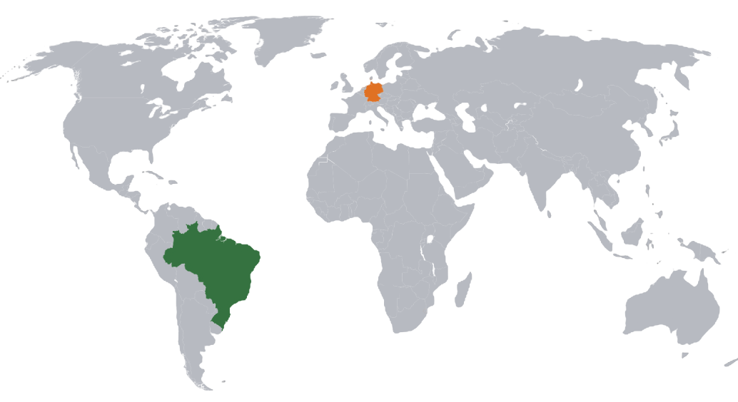
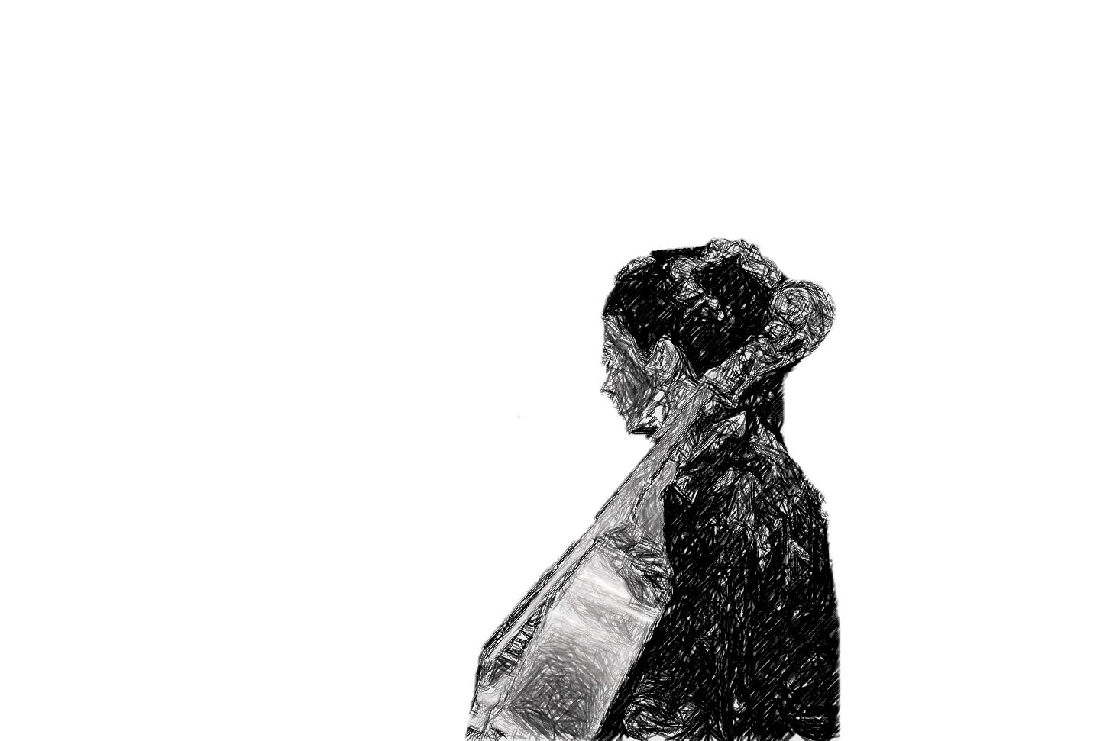
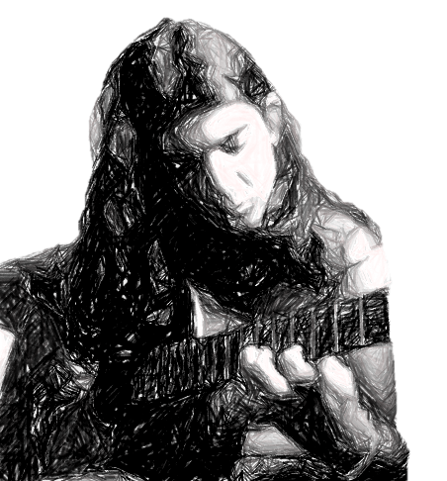
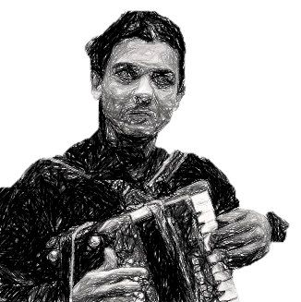
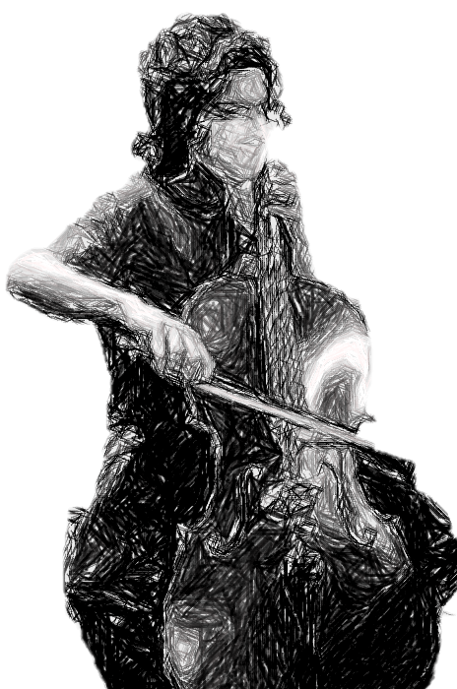
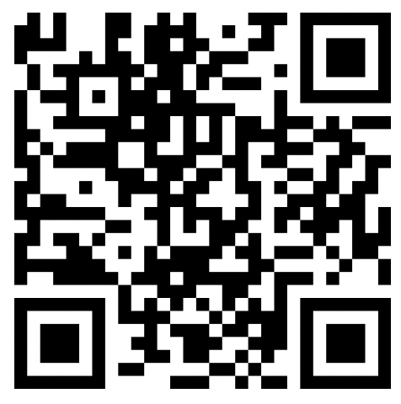
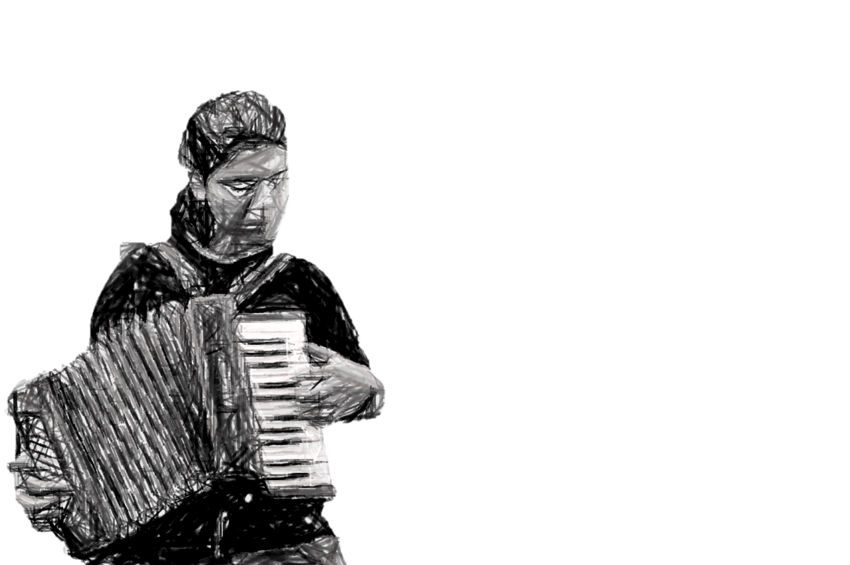
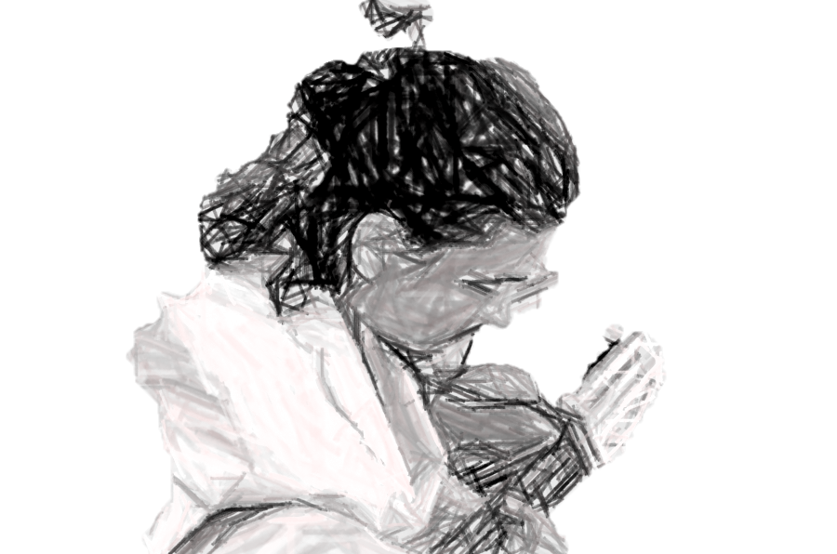
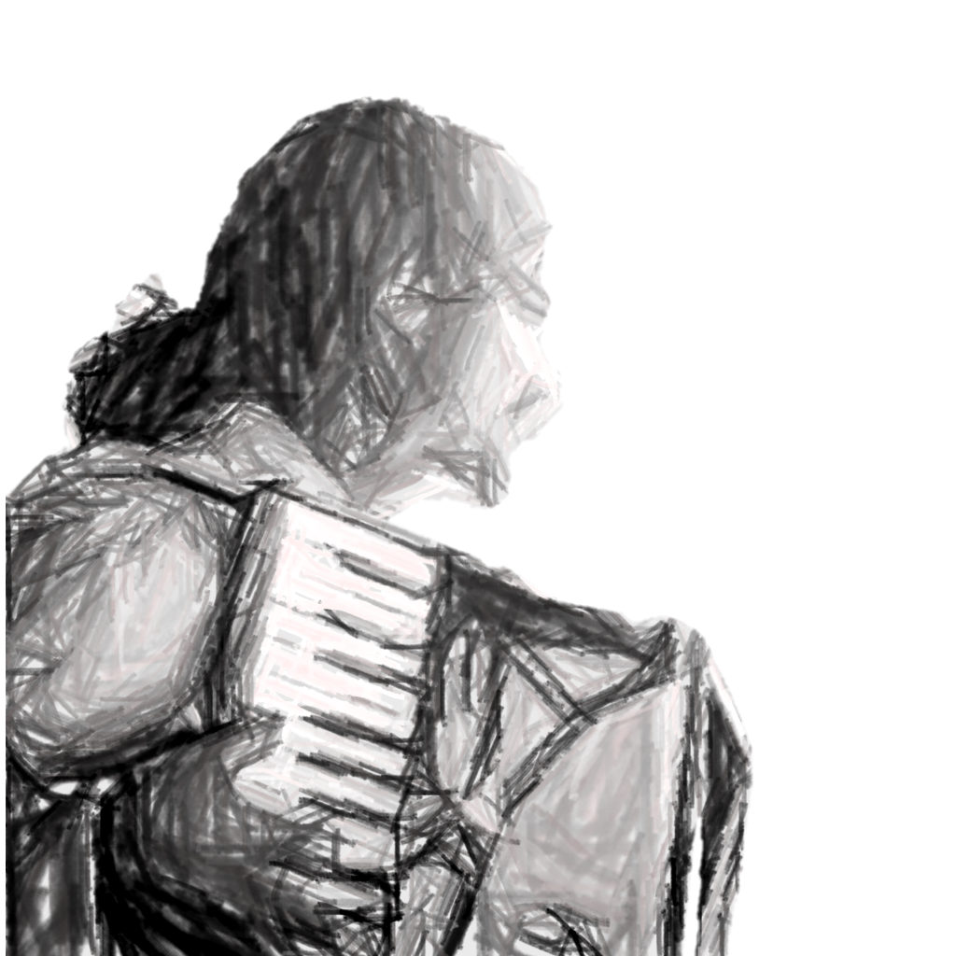
NEXT STEPS
DANKE!
October – Collect official data n=120
December - Analysis of the collected data
June 25 - Completion of the thesis
TAK!
MERCI!
OBRIGADO!
KIITOS!
GRACIAS!
For contact, to download examples, to learn more about my work, etc., visit:
ivanmoria.github.io
Email: ivanmoriabr@gmail.com

Slide 11
References
Agres, K. R., Schaefer, R. S., Volk, A., Van Hooren, S., Holzapfel, A., Dalla Bella, S., ... & Magee, W. L. (2021). Music, computing, and health: a roadmap for the current and future roles of music technology for health care and well-being. Music & Science, 4, 2059204321997709.
Clarke, E. (2004). Empirical methods in the study of performance. Empirical musicology: Aims, methods, prospects, 77-102.
Croom, A. (2015). Music practice and participation for psychological well-being: A review of
how music influences positive emotion, engagement, relationships, meaning, and
accomplishment. Musicae Scientiae, 19(1), 44-64.
Erkkilä, J. (2007) Music Therapy Toolbox (MTTB) - An Improvisation Analysis Tool for Clinicians and Researchers. In: Wosch, T., & Wigram, T. (Eds.), Microanalysis in music therapy. (Pp. 134-148). Jessica Kingsley Publishers
Gattino, G. (2020) Fundamentos de avaliação em Musicoterapia. Florianópolis, SC: Forma &
Conteúdo Comunicação Integrada.
He, H., Yang, M., Duan, M., Chen, X., Lai, Y., Xia, Y., ... & Yao, D. (2018). Music intervention
leads to increased insular connectivity and improved clinical symptoms in
schizophrenia. Frontiers in neuroscience, 11, 744.
Koelsch, S. (2009). A neuroscientific perspective on music therapy. Ann. NY Acad. Sci., 1169,
374-384.
Moriá, I. (2021). A cognição social em musicoterapia: perspectivas sobre a atuação na prática musical interativa em saúde mental.

